Slide 1
INSTRUCTIONS
Use Font size 22 to 28 and Font Style Times New Roman (body)
Do not change the Template: Heading / Title of the slides
Do not change font style or colours
Do not copy paste paragraphs: use only Bullet Points
Maximum slide Limit is 20 only
As per the number of supervisor allotted adopt slide-2 or slide-3
Please display the required meaningful Content or images or tables
Change the footer accordingly using insert tab then click on header & footer tab and edit it
Save the PPT with Register No, Dept and Review no, example: 23xxxxxxxxx_CSE

Slide 2

Title: RapidCare Blood Distribution Network Platform
Student Name: Pudota Asritha Chowdary
Student ID: 2520030592
Cluster:1
Section: 1
Under the Guidance
of
Supervisor Name: P Surekha
Assistant Professor
Department of CSE

Slide 3
OUTLINE
Abstract
Existing System
Proposed System
System Architecture
Project Modules
Objectives
Co’s Attainments - FWD
Co1
Co2 …….. 5. Co5
Co’s Attainments - DSA
Co1
Co2 …….. 5. Co5
Screen Shots for FWD & DSA
Conclusion
Geo-Tagged Photos

Slide 4
Abstract
RapidCare Blood Distribution Network Platform is a web-based system designed to manage and coordinate blood requests between hospitals and donors.
The platform is developed using HTML, CSS, and JavaScript to provide a simple and interactive user interface.
It allows users to add, search, sort, and manage blood request records efficiently.
The system uses Data Structures and Algorithms (DSA) concepts such as arrays and searching techniques to organize and process data.
The platform helps in quickly identifying available blood types and managing request information.
This project demonstrates the practical application of DSA concepts to solve real-world healthcare management problems.

Slide 5
Existing System
Blood distribution and donor information are mostly managed manually through phone calls, paper records, or basic spreadsheets.
Hospitals often face difficulty in quickly finding available blood donors during emergencies.
There is no centralized system to store and manage blood request information.
Communication between hospitals, blood banks, and donors is slow and inefficient.
Manual record management can lead to data loss, errors, and difficulty in updating information.
Searching for specific blood groups or donor details takes more time and effort.
The existing process lacks automation and real-time updates, which may delay urgent blood supply.

Slide 6
Proposed System
The proposed system provides a efficiently. web-based platform to manage blood distribution requests
It maintains a centralized database to store donor, hospital, and blood request information.
Users can add, search, update, and delete blood request records easily.
The system uses Data Structures and Algorithms to organize and search blood data efficiently.
It improves communication between hospitals, donors, and blood banks.
The platform reduces manual errors and saves time through automation.
It offers a simple and user-friendly interface using HTML, CSS, and JavaScript.
The system helps provide faster response during emergency blood requirements.

Slide 7
System Architecture
The system is developed as a web-based application for managing blood distribution requests.
The frontend interface is built using HTML, CSS, and JavaScript.
Users can enter blood requests and view available blood information through the web interface.
The system processes user inputs and performs operations like add, search, and sort.
Data Structures and Algorithms (DSA) are used to organize and manage the blood request data efficiently.
The system stores information such as blood group, donor details, and hospital requests.
The platform helps hospitals quickly find available blood groups during emergencies

Slide 8
The system connects donors, hospitals, and blood banks in a single platform.
It reduces manual work by automating the blood request management process.
The architecture ensures faster data processing and easy data management.
The platform provides a simple and user-friendly interface for users.
The system improves the efficiency of blood distribution and request handling.
The system allows users to update and delete blood request records when needed.
The plat from helps maintain organized and accurate blood distribution data for better management.

Slide 9
Project Modules
User Registration Module – Allows users or donors to register by entering their basic details.
User Login Module – Enables registered users to securely log in to the system.
Blood Request Management Module – Allows hospitals or users to add and manage blood requests.
Donor Information Module – Stores and displays donor details such as name, blood group, and contact information.
Search and Filter Module – Helps users quickly find required blood groups using search and sorting methods.
Blood Availability Module – Displays available blood units and their details.
Request Update/Delete Module – Allows users to update or remove existing blood request records.
Admin Management Module – Enables the admin to monitor and manage all system data.

Slide 10
Objectives
To develop a web-based platform for managing blood distribution requests efficiently.
To provide a centralized system for storing donor and blood request information.
To reduce the time required to find suitable blood donors during emergencies.
To implement Data Structures and Algorithms (DSA) for efficient data management and searching.
To improve communication between hospitals, donors, and blood banks.
To reduce manual errors by automating the blood request management process.
To provide a simple and user-friendly interface for users to access blood information easily

Slide 11
Co’s Attainments - FWD
CO1 – Understanding Internet and Web Concepts The project demonstrates knowledge of web technologies, browser functionality, and client–server web architecture while developing and running the web application.
CO2 – Applying HTML and CSS for Web Page Design The project uses HTML for structuring web pages and CSS for styling, layout design, and responsive interface creation.
CO3 – Implementing JavaScript Programming Concepts JavaScript is used in the project to implement conditions, functions, loops, and interactive features for handling user actions.
CO4 – Using DOM Manipulation and Event Handling The project applies DOM manipulation and event handling to manage user inputs, update page content dynamically, and handle form interactions.
CO5 – Integrating Advanced Web Development Features The project demonstrates form validation, dynamic data handling, and optimization concepts while building a functional web-based system.

Slide 12
Co’s Attainments - DSA
CO1 – Analysis of Algorithms and Searching/Sorting Techniques The project applies searching and sorting techniques to manage and organize blood request records efficiently.
CO2 – Linked List Data Structures The project conceptually demonstrates data organization similar to linked lists for managing blood donor and request records.
CO3 – Stack and Queue Data Structures The system can use queue-based logic to handle blood requests in order of priority or arrival.
CO4 – Hashing Techniques The project conceptually uses hashing ideas for quick searching of blood groups and donor details.
CO5 – Application of Linear Data Structures in Real-World Problems The project shows how linear data structures can be used in real-time applications like blood distribution management.
CO6 – Applying Data Structures to Real-World Applications The project demonstrates the practical use of data structures and algorithms to solve real-world healthcare management problems.

Slide 13
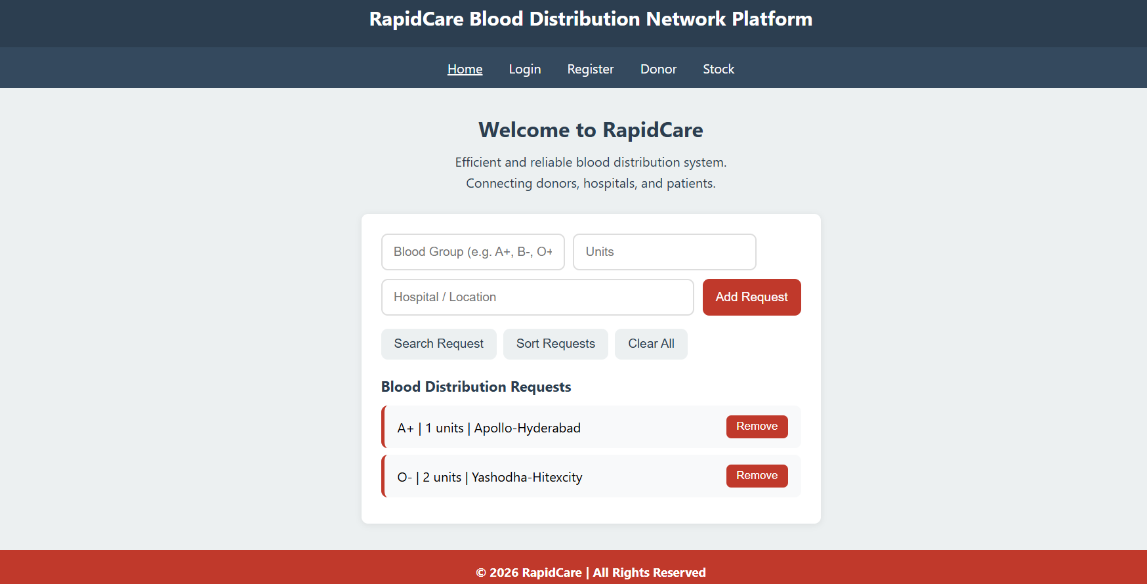
Screenshots for FWD & DSA

Slide 14
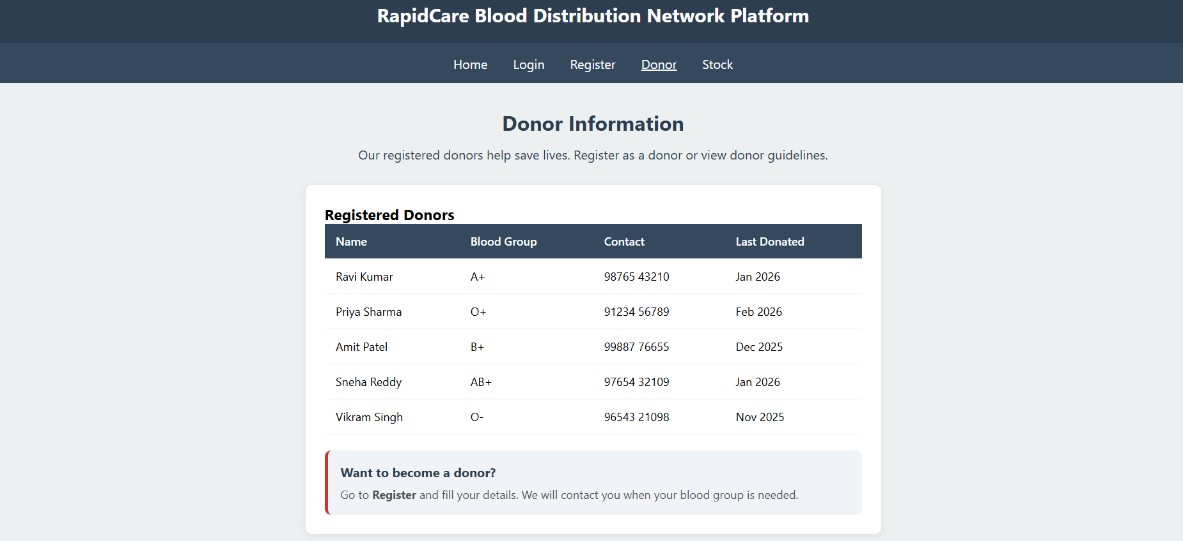

Slide 15
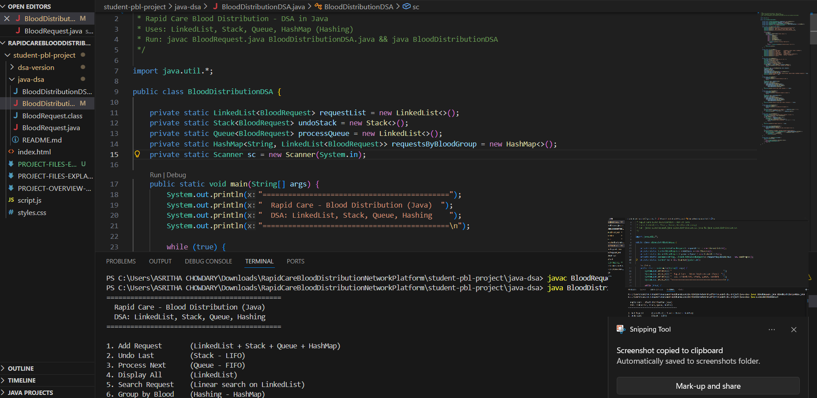

Slide 16
Conclusion
The RapidCare Blood Distribution Network Platform was developed to simplify and improve the management of blood distribution requests.
The system provides a web-based interface to store, search, and manage blood request and donor information efficiently.
By using HTML, CSS, and JavaScript, the project creates a simple and interactive platform for users.
The implementation of Data Structures and Algorithms (DSA) helps in organizing and retrieving blood data effectively.
The platform reduces manual effort and improves the speed of finding required blood groups during emergencies.
Overall, the project demonstrates how web technologies and data structures can be applied to solve real-world healthcare problems.

Slide 17
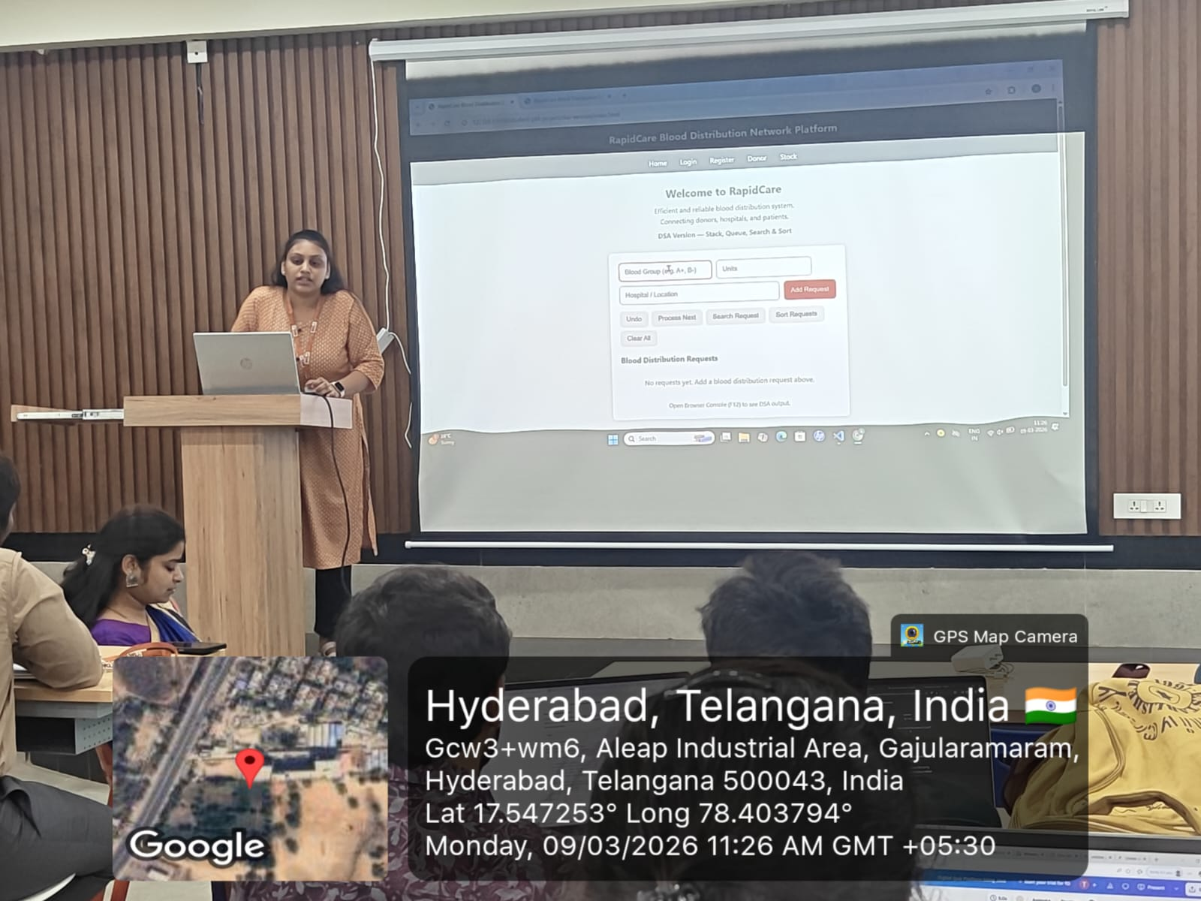
Geo- Tag Photos

Slide 18
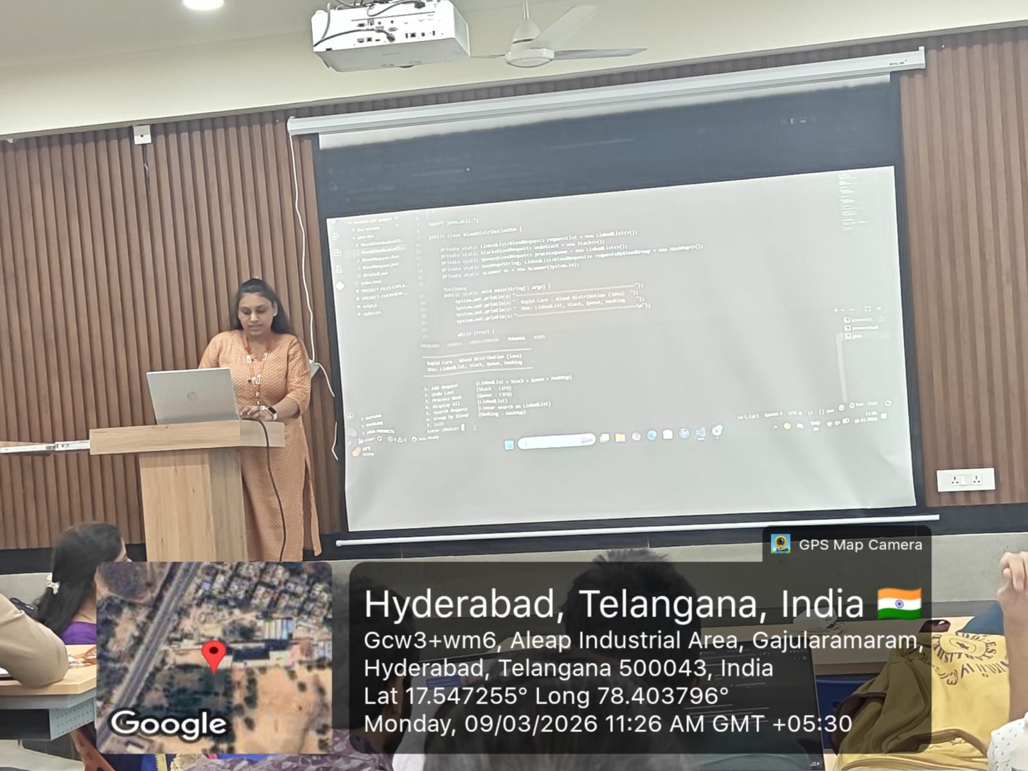

Slide 19
THANK YOU

